Slide 1
NE 763: Advanced Reactor Materials
Fall 2025
Dr. Benjamin Beeler

Slide 2
Extra Info on TRISO reprocessing
Historical methods:
Previous processing of TRISO fuel was based on crushing the graphite fuel blocks and separating the coated fuel particles from the graphite. Oxidation was then used to remove the filler carbon and the outer carbon layer, followed by crushing of the Sic shells and additional burning of the inner carbon layer. The remnant ashes were leached using nitric acid and the resulting solution interfaced with conventional solvent extraction
Created lots of CO2 gas, which was radioactive due to C-14 generation
Currently exploring different methods of mechanical or chemical separation of TRISO particles from graphite, and subsequent separation of kernels from the TRISO particles
Acid intercalation, thermal shock, pyrometallurgical processes, chlorine gas, various electrolytic methods
Low Technological Readiness Level (TRL)
PNNL-32969 and ORNL/TM-2002/156 are key references

Slide 3
Last Time
Exam..
Before that: started on SFRs
Two fuel types:
MOX and metallic
Two reactor designs
pool type and loop type
Increased safety
high margin to boiling
inherent negative reactivity feedback coefficient
higher thermal conductivity -> higher overpower to melt
High swelling of alpha U: alpha tearing/cavitation swelling low T; higher T GB porosity

Slide 4
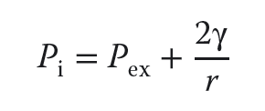
Swelling in Gamma U
Gamma U is BCC
Swelling in the higher temperature phases occurs primarily by growth of fission gas bubbles, and is isotropic
All phases will also have solid fission product swelling
Fission gas is effectively insoluble in metallic U, and thus prefers to precipitate
Sufficiently large bubbles can maintain an equilibrium gas pressure by balancing the surface tension and the external pressure
This growth is described by the Young-Laplace equation
The external pressure is determined by the plastic flow characteristics of the fuel surrounding the bubble and the mechanical restraint of the cladding
Fission gas swelling can be substantial, and must be accounted for

Slide 5
Alloying to modify properties
Small alloying additions were explored to limit the fission gas swelling behavior
Adjusted U – U alloyed with small amounts of Al, Fe, or Si
Additions form precipitates and act as point defect sinks, limiting swelling for low burnups
U-Fissium contained Mo-Ru, with lesser amounts of Rh, Pd, Zr, and Nb, and was the early EBR II fuel
Higher content alloys have focused on elements that form extensive solid solutions with U in the high-temperature γ-phase, specifically Mo, Zr, Ti, and Nb
These elements lower the temperature of the cubic γ-phase boundary, allowing more of the fuel to operate in the isotropic γ-phase; they also increase the solidus temperature, raising the margins at which the fuel melts
The addition of Zr and Mo seem to most substantially reduce the swelling of U

Slide 6
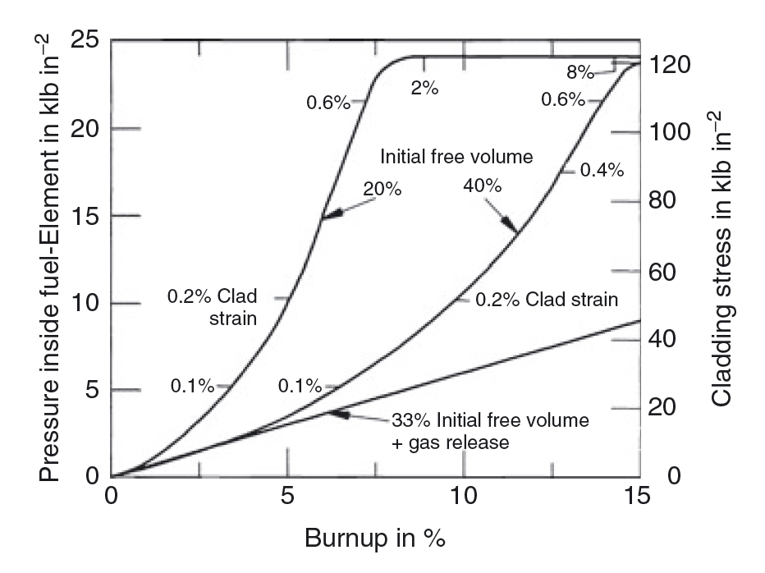
Accommodation of Swelling
With high-content alloys, calculations of fuel swelling and gas release showed that if 30-40% free volume was afforded inside the cladding, fuel could swell, and when it contacted the cladding, allowing for mechanical strength of cladding to counteract further radial swelling
It was found that the majority of fission gas is released by about 30% swelling, and by including a large plenum, stresses on cladding could be reduced

Slide 7
I told you that to tell you this…
Provided context to get us to the point where we can actually talk about the reactor system

Slide 8
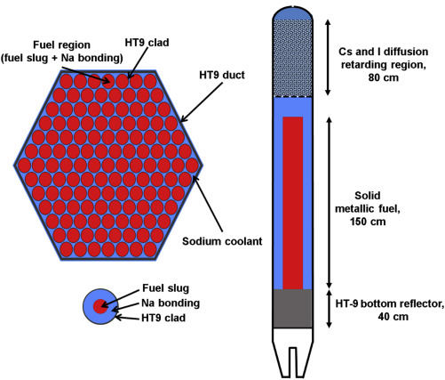
Reactor Geometries
Metal fuels are ideal for fast reactors because they have higher densities of fissile and fertile materials and provide higher breeding ratio
The burnup of metal fuel in the early days was limited to a few atom percent (at.%) because of the increase in the fuel–cladding mechanical interaction (FCMI) caused by gas swelling of fuel alloys
Reducing the fuel smear density to about 75% is effective in promoting fission gas release before fuel-cladding contact and in suppressing FCMI

Slide 9
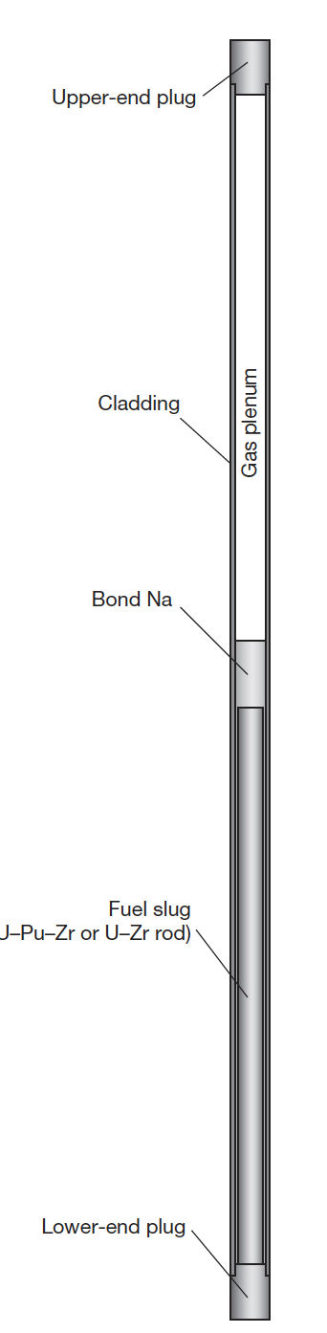
Base Metal Fuel System
The typical metallic fuel consists of a U(Pu)–10 wt% Zr fuel slug with ~75% smear density
The cylindrical fuel alloy rod is called a ‘fuel slug
The annular gap between the fuel slug and the cladding is filled with sodium (bond sodium)
A relatively large gas plenum (1-1.5x fuel length), which is a space above the fuel slug, is provided to mitigate the pressure of the fission gas accumulating during irradiation

Slide 10
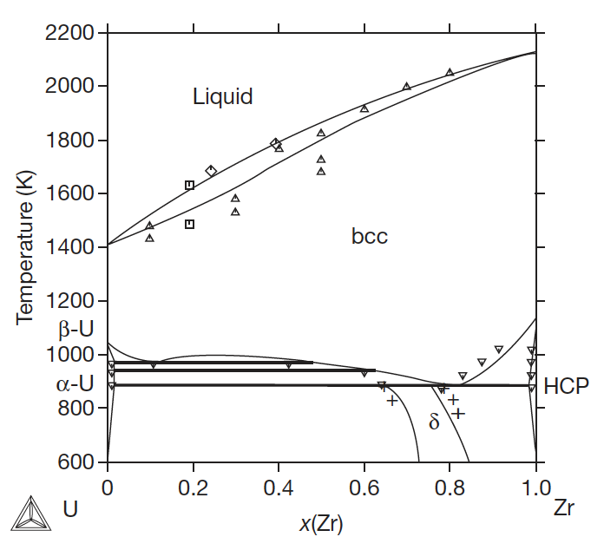

The U-Zr System
Metallic uranium is alloyed with Zr to stabilize the bcc phase, increase the melting point, improve mechanical properties, and reduce swelling
Typical composition is 10 wt.%, or approximately 23 atom %
At relevant temperature ranges in SFRs, multiple phases will be present

Slide 11
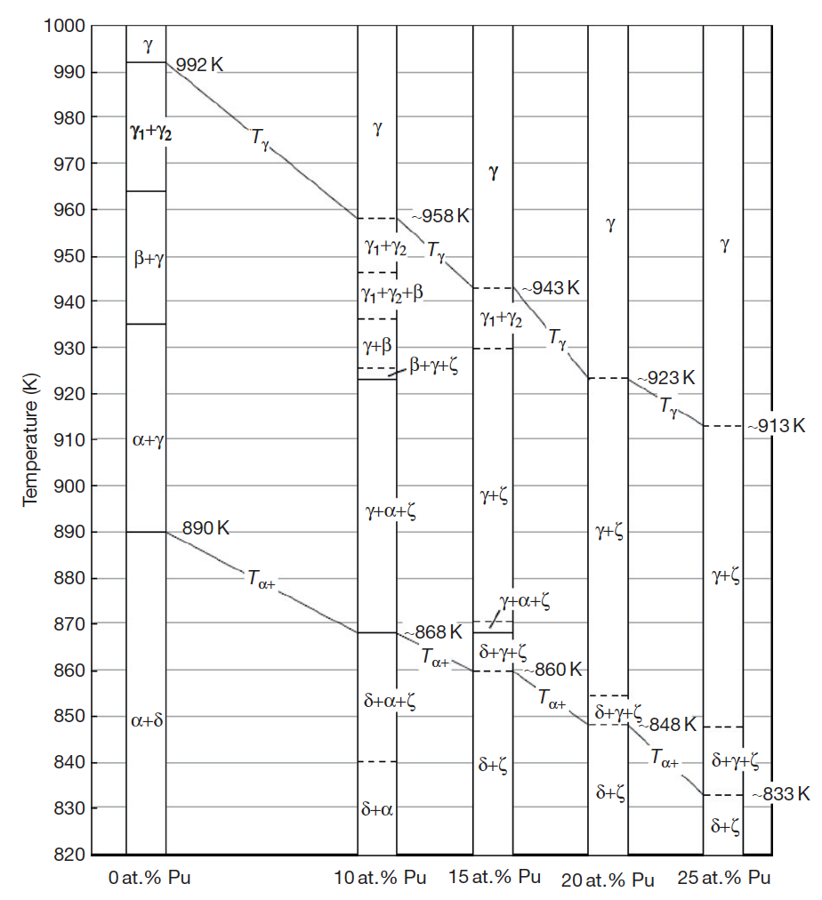
U-Pu-Zr
Ternary phase diagram isotherms
γ: Body-centered cubic (bcc), has complete solid solubility for bcc ε-plutonium and bcc β-zirconium
α: Orthorhombic allotropic modification of uranium that dissolves up to 15 at.% of plutonium, but has limited solubility for zirconium
β: Tetragonal allotropic modification of uranium that dissolves up to 20 at.% of plutonium, but has limited solubility for zirconium
η: A high-temperature intermediate phase in the U–Pu binary system that is believed to be tetragonal and has limited solubility for zirconium
ζ: A complex cubic U–Pu intermediate phase that dissolves up to 5 at.% zirconium
δ: A hexagonal intermediate phase in the U–Zr system that occurs approximately at the composition UZr2 and has extensive solid solubility for plutonium

Slide 12
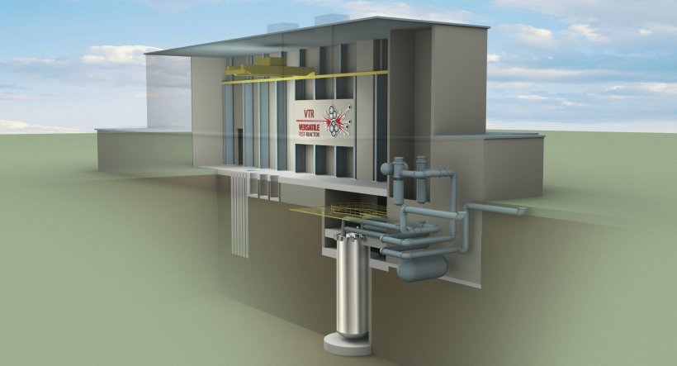
U-Pu-Zr
The U-Pu-Zr system was the fuel choice for the Integral Fast Reactor design of the 1980s, and the current Versatile Test Reactor design
U-Pu-Zr alloys are the most recent alloys under active exploration, and thus have the most recent experimental data

Slide 13
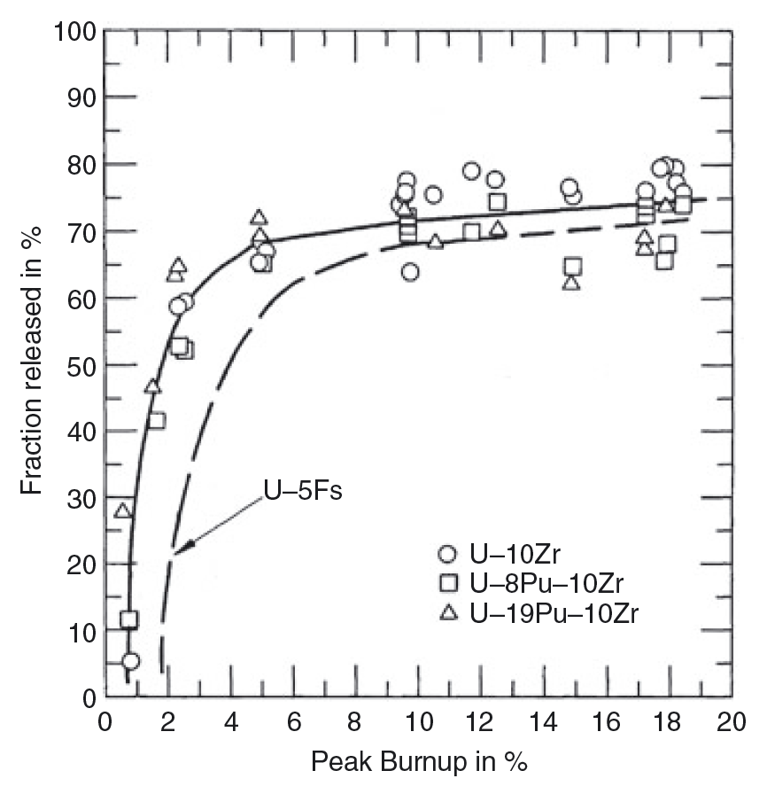
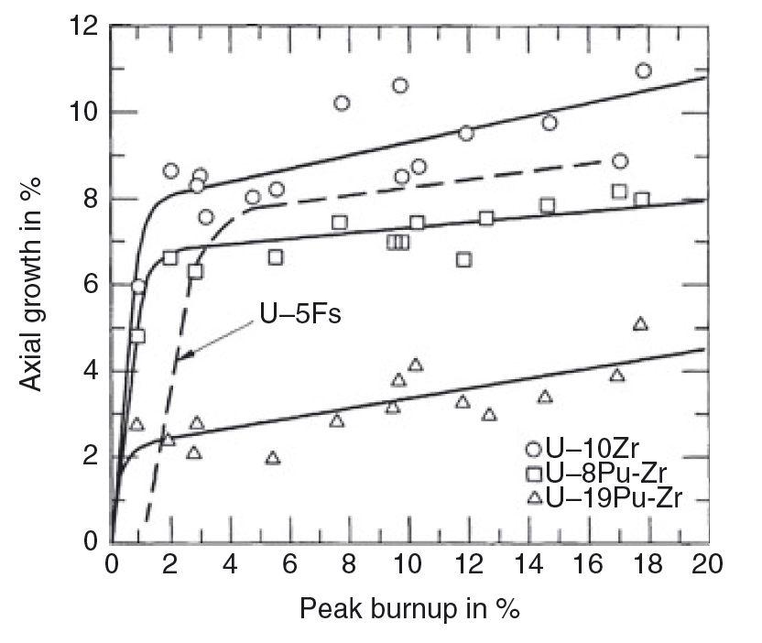
U-Pu-Zr Swelling
Swelling is typical of metallic fuels, in that it occurs rapidly, leveling off once in contact with the cladding
Fission gas release occurs within the first 5% burnup, corresponding with the rapid swelling
These fuels swell less in the axial direction than in the radial direction, if isotropic swelling is assumed

Slide 14
U-Pu-Zr Swelling
The is believed to be due to the difference in swelling behavior between the hotter center of the fuel pin and the colder periphery
The gamma phase dominates in the center of the fuel pin at high temperatures
This phase has large gas bubbles, indicative of a higher plasticity of the fuel and, therefore, a lower capability to sustain shear stresses
gamma

Slide 15
U-Pu-Zr Swelling
The alpha phase dominates on the colder periphery of the fuel pin, and has smaller, textured porosity
The alpha phase is known to have higher strength, and is assumed to be less plastic than gamma
The fission gas pressure in the center would can potentially result in a near-biaxial loading of the peripheral shell, the radial stress component being twice the axial component
A stress effect on swelling in the peripheral fuel zone would result in a larger radial strain, and hence anisotropic swelling
alpha

Slide 16
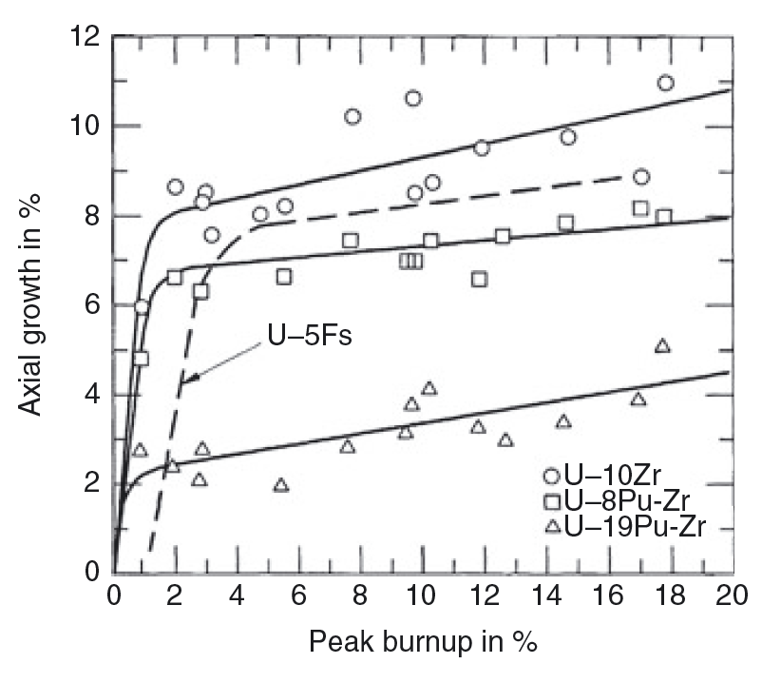
U-Pu-Zr
An increase in the Pu content exacerbates the anisotropic swelling
This is believed to be driven by the redistribution of Zr along the temperature gradient of the fuel

Slide 17
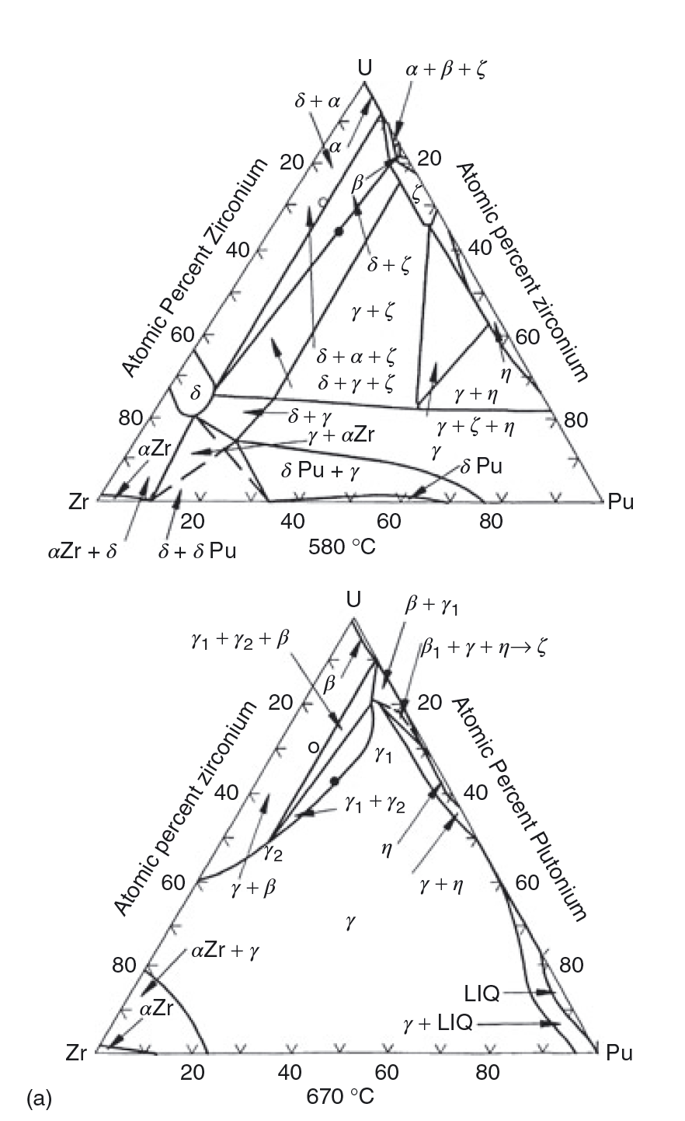
U-Pu-Zr Phases
Various phase boundaries exist radially across the fuel
The solubility of Zr in these phases varies with temperature; thus, a driving force for diffusion can be created both by the gradient in chemical potential, and by the temperature gradient

Slide 18
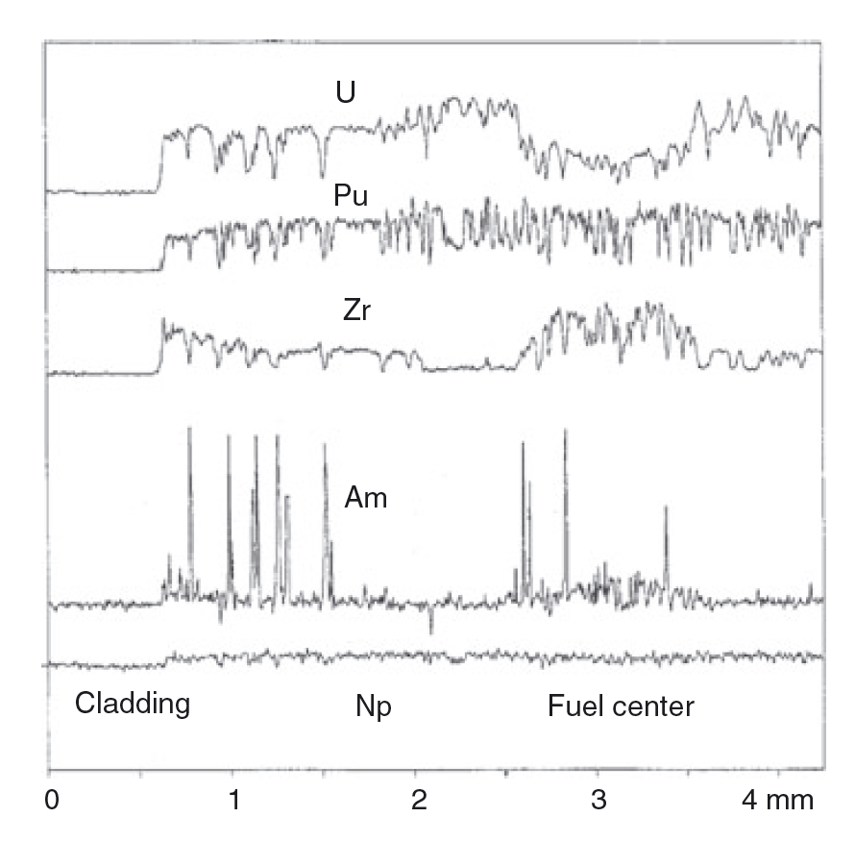
Redistribution
There can exist three compositional regions: 1) enriched Zr, 2) depleted Zr, 3) as-fabricated Zr
Zirconium diffuses up the temperature gradient to the high temperature gamma phase, leaving the intermediate temperature beta U phase
Uranium compensates by diffusing to the intermediate region
At lower T, decomposition into alpha/delta phases – with local low and high Zr content

Slide 19
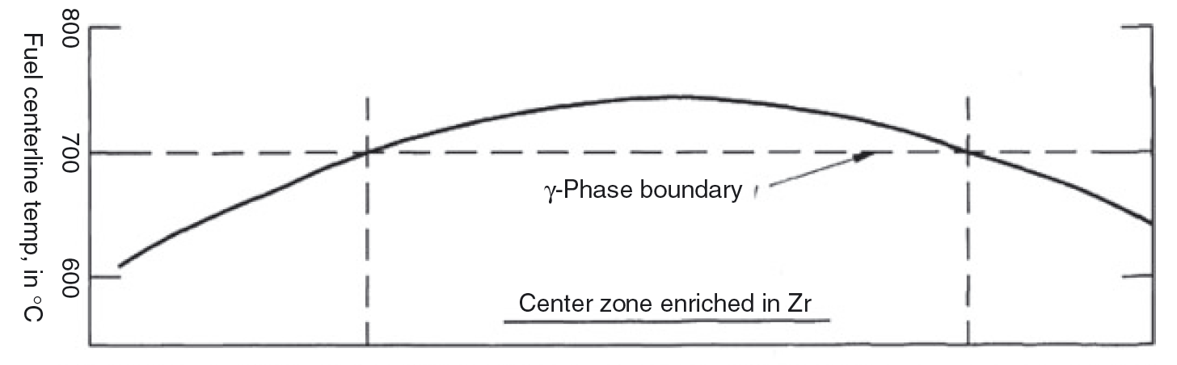
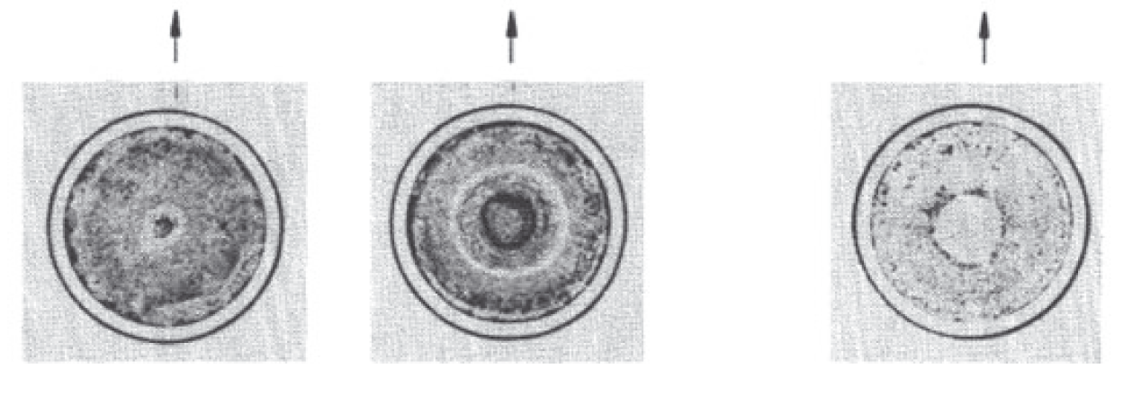
Redistribution
The location of the radial zones essentially follows isotherms in the fuel which are determined by the various phase boundaries of the alloy
The extent of redistribution, and the radial location of the individual compositional regions, varies axially with temperature
Both chemical potential and Soret effect diffusion contribute

Slide 20
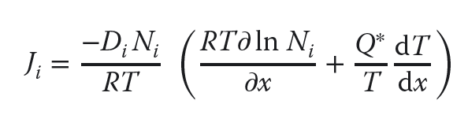
Soret Diffusion
Soret effect is a phenomenon observed in mixtures of mobile particles where the different particle types exhibit different responses to the force of a temperature gradient
The solute flux in a temperature gradient is characterized by the heat of transport, Q*, of the migrating solute according to Fick’s law:
where Di and Ni are the diffusivity and concentration of the migrating solute
The heat of transport can be either positive or negative, depending on the sign and magnitude of its components

Slide 21
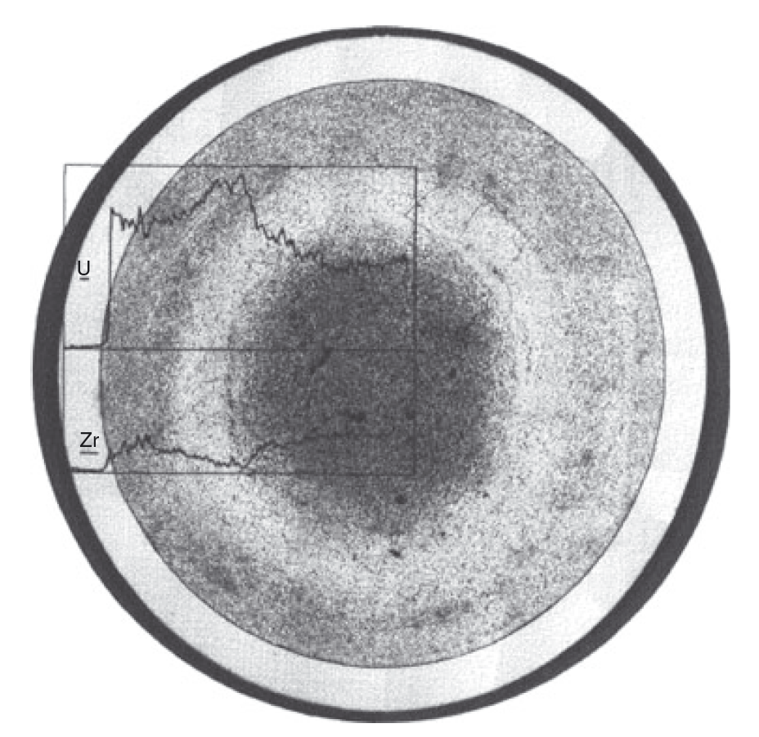
Soret Diffusion in UZr
The value of Q* for pure U was measured to be +5 kcal/mol and to be −34 kcal/mol for Zr
Thus, in their pure states, U moves down a temperature gradient while Zr moves up, but it is unknown if this behavior directly translated to U-Zr alloys
For low Pu content alloys, the rate of redistribution is similar to UZr

Slide 22
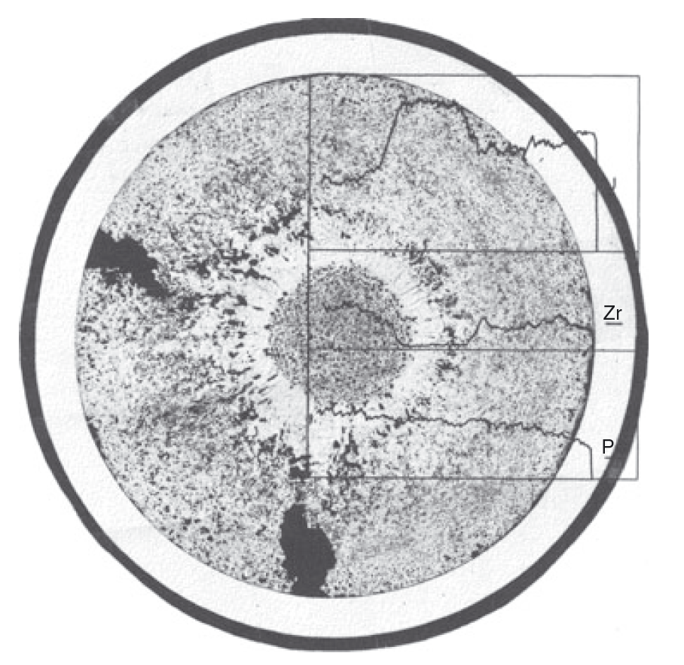
Soret Diffusion in UZr
For high Pu content alloys (>19%), redistribution is much more rapid
At the right is a 3% burnup fuel slug at a similar power density to the U-Zr slug in the previous slide
There is either a higher chemical driving force, or more rapid Zr diffusion present in these alloys
This more rapid redistribution can lead to greater anisotropic swelling, and thus more rapid radial swelling

Slide 23
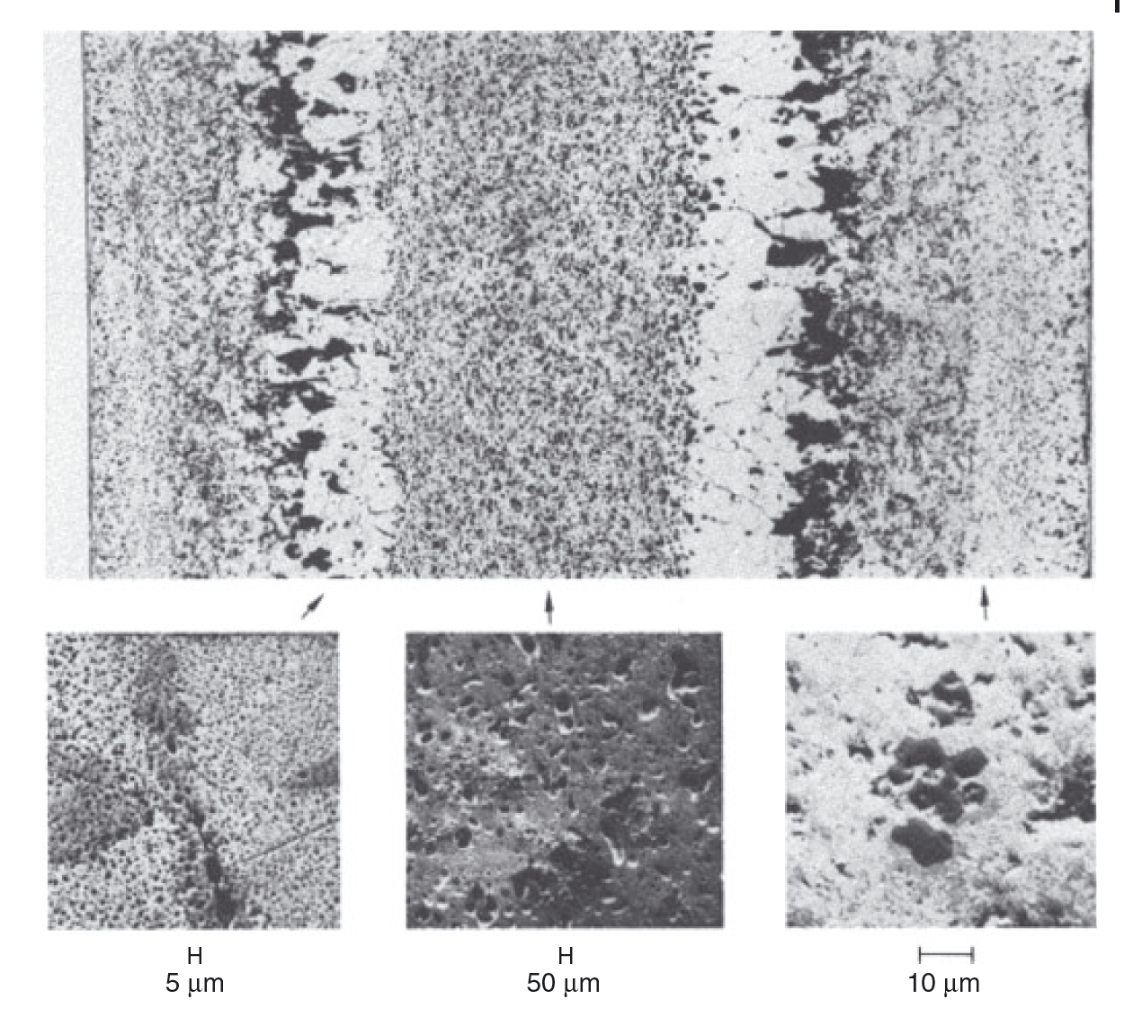
Variable Porosity
The porosity development depends on the phases present in the fuel
In all alloys, the high-temperature cubic U γ-phase exhibits the characteristic large interconnected bubbles similar to those observed in pure γ uranium
Different bubble sizes, densities, and morphologies can exist depending upon the local phase

Slide 24
Variable Porosity
In U-Zr alloys, low-temperature U alpha phase and UZr2 delta phase form a laminar microstructure and the pore morphology follows this microstructure

